Slide 1
WHAT IS CLOUD ?

Slide 2
WHAT IS CLOUD ? :- The term cloud refers to a network or the internet. It is a technology that uses remote servers on the internet to store, manage, and access data online rather than local drives. The data can be anything such as files, images, documents, audio, video, and more .

Slide 3
There are the following operations that we can do using cloud computing:
Developing new applications and services
Storage, back up, and recovery of data
Hosting blogs and websites
Delivery of software on demand
Analysis of data
Streaming videos and audios

Slide 4
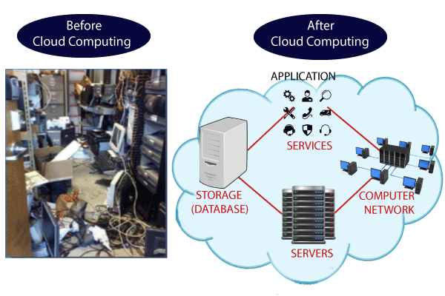

Slide 5
Characteristics of Cloud Computing
The characteristics of cloud computing are given below:
1) Agility
The cloud works in a distributed computing environment. It shares resources among users and works very fast.
2) High availability and reliability
The availability of servers is high and more reliable because the chances of infrastructure failure are minimum.
3) High Scalability
Cloud offers "on-demand" provisioning of resources on a large scale, without having engineers for peak loads.
4) Multi-Sharing
With the help of cloud computing, multiple users and applications can work more efficiently with cost reductions by sharing common infrastructure.
5) Device and Location Independence
Cloud computing enables the users to access systems using a web browser regardless of their location or what device they use e.g. PC, mobile phone, etc. As infrastructure is off-site (typically provided by a third-party) and accessed via the Internet, users can connect from anywhere.

Slide 6
6) Maintenance
Maintenance of cloud computing applications is easier, since they do not need to be installed on each user's computer and can be accessed from different places. So, it reduces the cost also.
7) Low Cost
By using cloud computing, the cost will be reduced because to take the services of cloud computing, IT company need not to set its own infrastructure and pay-as-per usage of resources.
8) Services in the pay-per-use mode
Application Programming Interfaces (APIs) are provided to the users so that they can access services on the cloud by using these APIs and pay the charges as per the usage of services.

